Slide 1
Rockbuster stealth
Date analysis project by Jamie Persson

Slide 2
Overview
Use existing movie licenses to launch an online video rental service in order to stay competitive.
Assist business intelligence department with launch strategy for new online video service through data analysis.
Project Objectives
Which movies contributed most and least to revenue gain?
What was the average rental duration for all videos?
Which countries are Rockbuster customers based in?
Where are customers with a high lifetime value based?
Do sales figures vary between geographic regions?
KEY QUESTIONS

Slide 3
Rockbuster Statistics (2006)
Average Rental Duration
Number of Movie Titles
5 Days
1000
Number of Customers
599
Total Revenue
$61,312
Average Rental Rate
$2.98
Number of Countries
108

Slide 4
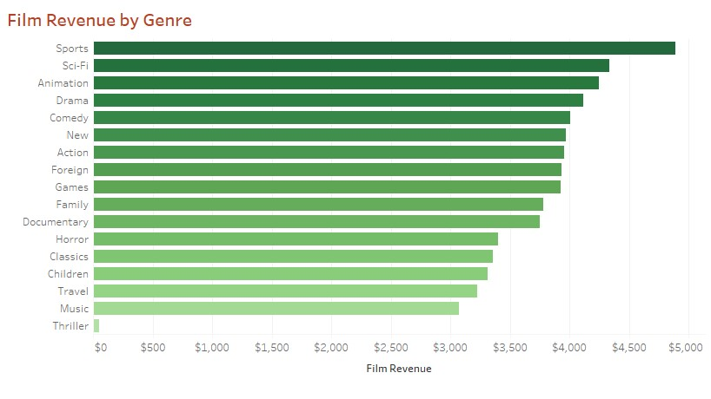
Genre Popularity
Top-selling genres include Sports, Sci-Fi, and Animation.
Thriller genre contributed lowest revenue.

Slide 5
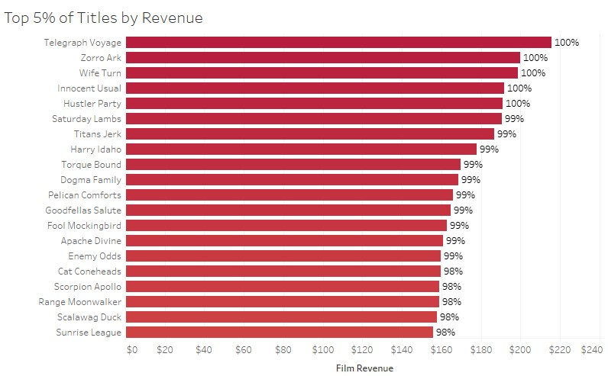
Movie Performance Based on Revenue
Telegraph Voyage, Zorro Ark, and Wife Turn are highest performing titles.
List of Titles that Generated Zero Revenue
Butch Panther | Tadpole Park | Crossing Divorce
Wake Jaws | Hocus Frida | Kentuckian Giant
Pearl Destiny | Alice Fantasia | Gump Date
Gladiator Westward | Order Betrayed | Hate Handicap
Arsenic Independence | Boondock Ballroom | Argonauts Town
Chinatown Gladiator | Apollo Teen | Raiders Antitrust
Sister Freddy | Catch Amistad | Treasure Command
Suicides Silence | Firehouse Vietnam | Frankenstein Stranger
Rainbow Shock | Deliverance Mulholland | Volume House
Ark Ridgemont | Psycho Shrunk | Kill Brotherhood
Sky Miracle | Chocolate Duck | Muppet Mile
Crystal Breaking | Floats Garden | Dazed Punk
Commandments Express | Walls Artist | Villain Desperate
Roof Champion | Crowds Telemark | Perdition Fargo
https://public.tableau.com/app/profile/jamie.persson/viz/DataImmersionTask3_10TitlesbyRevenue/Sheet1?publish=yes
For dynamic visualization see:

Slide 6
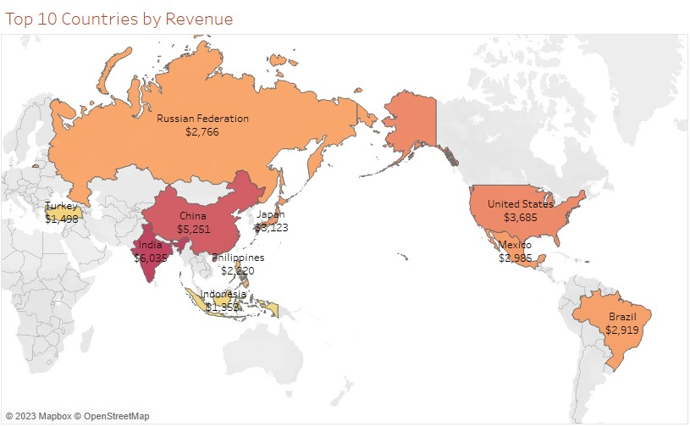

Revenue By Country
India, China, and the United States generate the highest revenue for Rockbuster.
To see revenue for all countries visit:
https://public.tableau.com/app/profile/jamie.persson/viz/DataImmersionTask3_10CountryRevenue/Sheet1?publish=yes

Slide 7
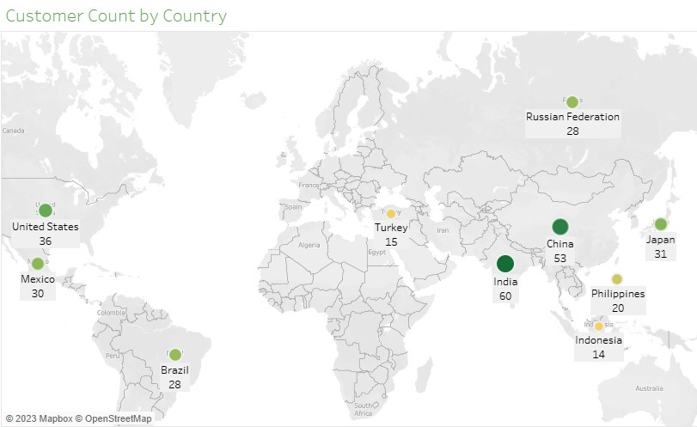

Customers By Country
Top 10 countries by customer count are consistent with those that generate highest revenue.
Customers with high lifetime value:
Customer | Country | Total Payment
Eleanor Hunt | Runion | $211.55
Karl Seal | United States | $208.58
Marion Snyder | Brazil | $194.61
Rhonda Kennedy | Netherlands | $191.62
Clara Shaw | Belarus | $189.60
Tommy Collazo | Iran | $183.63
Ana Bradley | United States | $167.67
Curtis Irby | Canada | $167.62
Marcia Dean | Philippines | $166.61
Mike Way | India | $162.67
For all countries:
https://public.tableau.com/app/profile/jamie.persson/viz/Task3_10CustomerCountbyCountry/Sheet1?publish=yes

Slide 8
Recommendations
Add more titles to the Sports, Sci-Fi, Animation, and other popular genres.
Do not renew licenses for film titles that did not generate revenue.
Focus marketing efforts in top 10 countries.
Offer promotions for new customers to encourage growth.
Provide incentives for most valuable customers.

